Slide 1
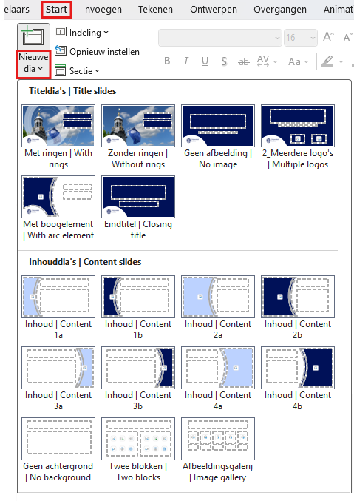
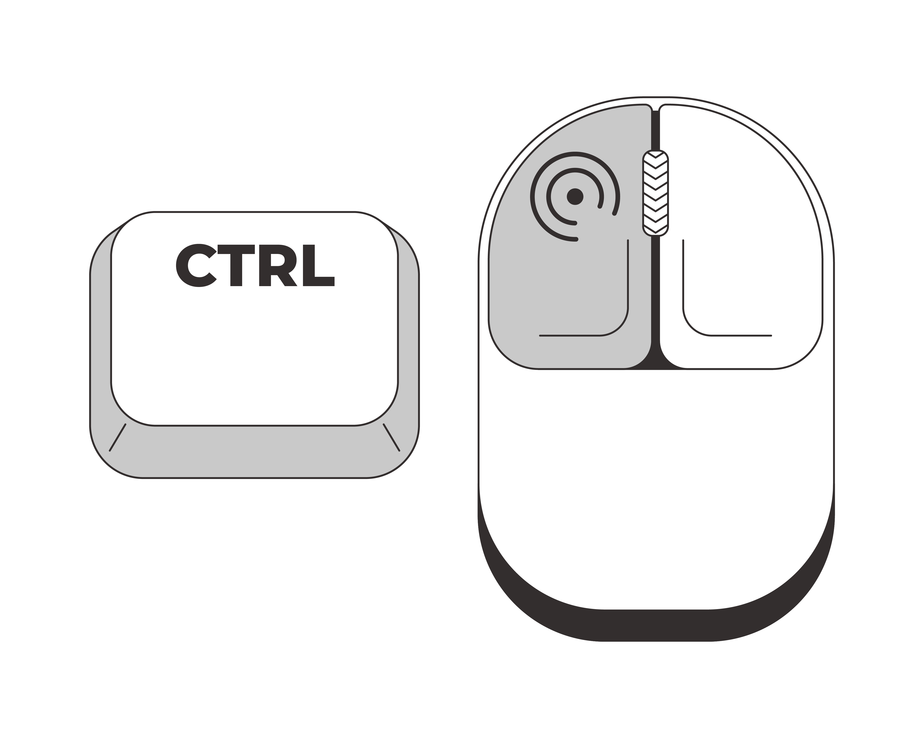
Nieuwe dia toevoegen
Ga in het menu naar het onderdeel Start en klik op onderste helft van de knop Nieuwe dia. Selecteer de gewenste titel- of inhouddia.
Adding a new slide
In the menu, go to the Start section and click the bottom half of the New slide button. Select the desired title slide or content slide.
Hulp nodig?
Lees deze instructies
Ctrl + klikken om te openen
Need help?
Read these instructions
Ctrl + click to open

Slide 2
Discover Leiden University

Slide 3

First university in the Netherlands
Founded by William of Orange in 1575
Our motto
Praesidium Libertatis: Bastion of Freedom
Notes:
Leiden University was founded by William of Orange and its links to the House of Orange go back centuries. Legend has it that the people of Leiden were given the choice: no taxes or a university. Our logo features Minerva, the goddess of wisdom, bearing a shield and a book. This photo of Minerva is by photographer Erwin Olaf.
(https://www.universiteitleiden.nl/en/about-us/profile/history)
Freedom of speech and thought is fundamental to our university, and we have lived for centuries by our motto, Bastion of Freedom. Nelson Mandela, Winston Churchill and Princess Beatrix (the former queen of the Netherlands) have been awarded honorary doctorates for defending freedom.
(https://www.universiteitleiden.nl/en/about-us/profile)

Slide 4
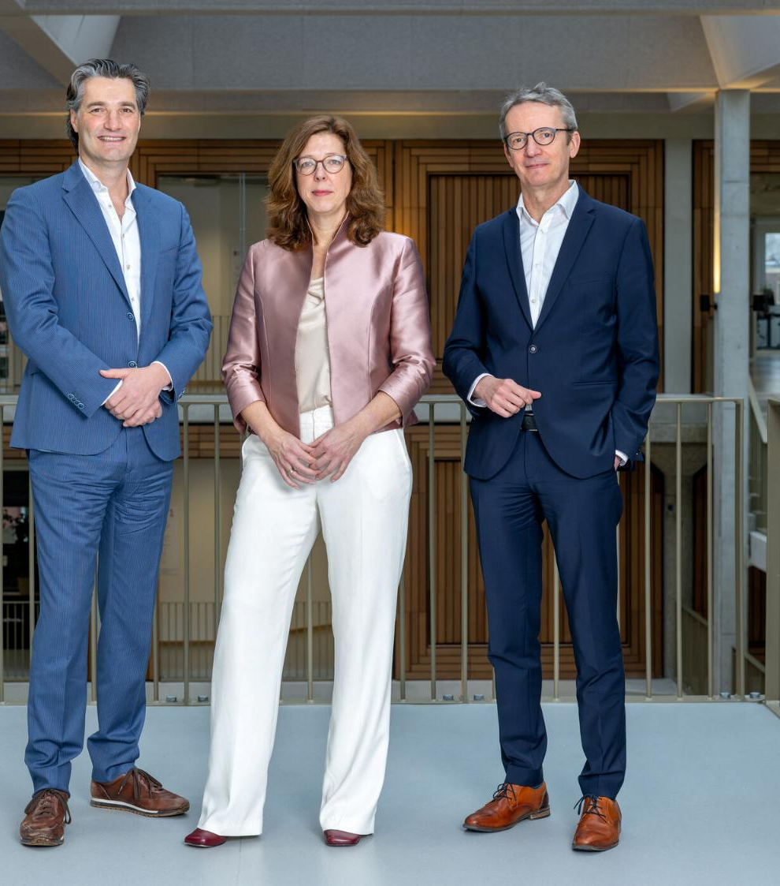
Board of Governors
Executive Board
University Council
Faculties
Archaeology
Governance and Global Affairs
Humanities
Law
Medicine/LUMC
Science
Social and Behavioural Sciences
Interfaculty institutes
Expertise centres/support services
Administration and Central Services
Notes:
The photo is of Leiden University’s Executive Board, with (l-r): Timo Kos (Vice-President), Sarah de Rijcke (Rector Magnificus) and Luc Sels (President).
The chart illustrates our organisational structure.
The university has seven faculties, all of which are based in Leiden and The Hague.
Each institute belongs to one or more faculties. Leiden University has 32 institutes, four of which are interfaculty.
https://www.universiteitleiden.nl/en/about-us/management-and-organisation/executive-board
https://www.universiteitleiden.nl/en/about-us/facts-and-figures/annual-reports

Slide 5
Faculties
Archaeology
Governance and Global Affairs
Humanities
Law
Medicine/LUMC
Science
Social and Behavioural Sciences
Notes:
Leiden University has seven faculties, located in both Leiden and The Hague. Within these faculties, academic research is carried out at various specialised research institutes. Leiden University has 32 institutes, four of which are interfaculty.
https://www.organisatiegids.universiteitleiden.nl/en/faculties-and-institutes

Slide 6
Leiden University in figures (2025)
2
Cities
7
Faculties
8,100
Staff members
51
Bachelor’s
programmes
83
Master’s
programmes
33,500
Students
165,000
Alumni
120
Nationalities
16
Nobel Prizes
Until now
Notes:
Figures from 2025 annual report and the DataKompas
Staff members: Headcount, including teaching and research staff affiliated with LUMC.
Exact numbers of students: 33,494

Slide 7
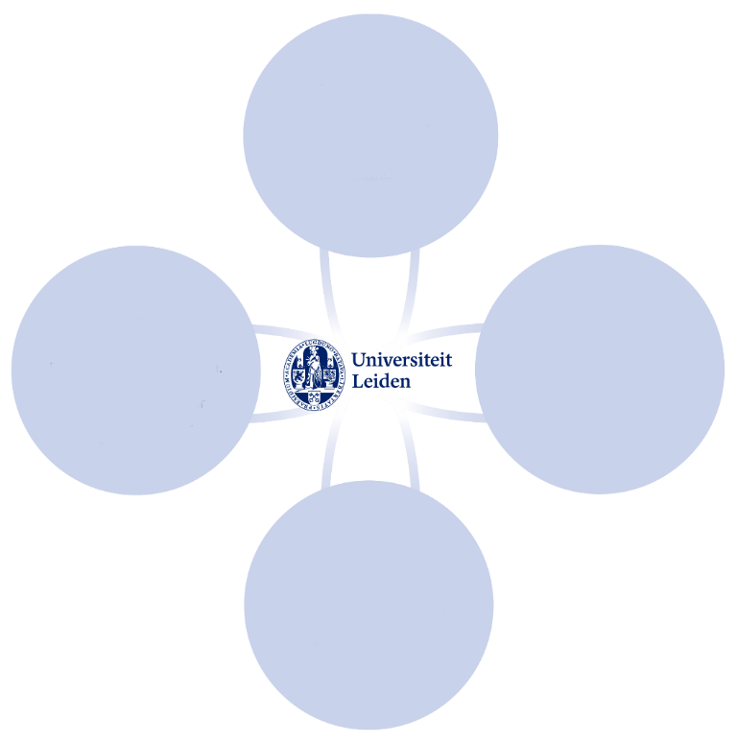
Innovating and Connecting
Strategic Plan 2022-2027
Room for innovation
Pioneering interdisciplinary research and teaching
Connecting
Future-proof student development
A healthy, involved and learning community
Innovative
Responsible
More value through strategic collaboration
Ample scope for talent and development
Free
Notes:
Strategic Plan 2022-2027. See strategicplan.universiteitleiden.nl
Innovative
Seeking new knowledge and understanding. Improving what can be improved. Shifting boundaries. Curious about one another and the unknown.
Connecting
Being part of a greater whole. Being successful together. Listening: to one another and to society. Actively contributing.
Free
Independent questioning. Offering scope for different perspectives and ideas, open discussion and curiosity-driven research.
Responsible
For promoting an inclusive community. For integrity in academic practice. For what we say and do, and how we interact with one another.

Slide 8
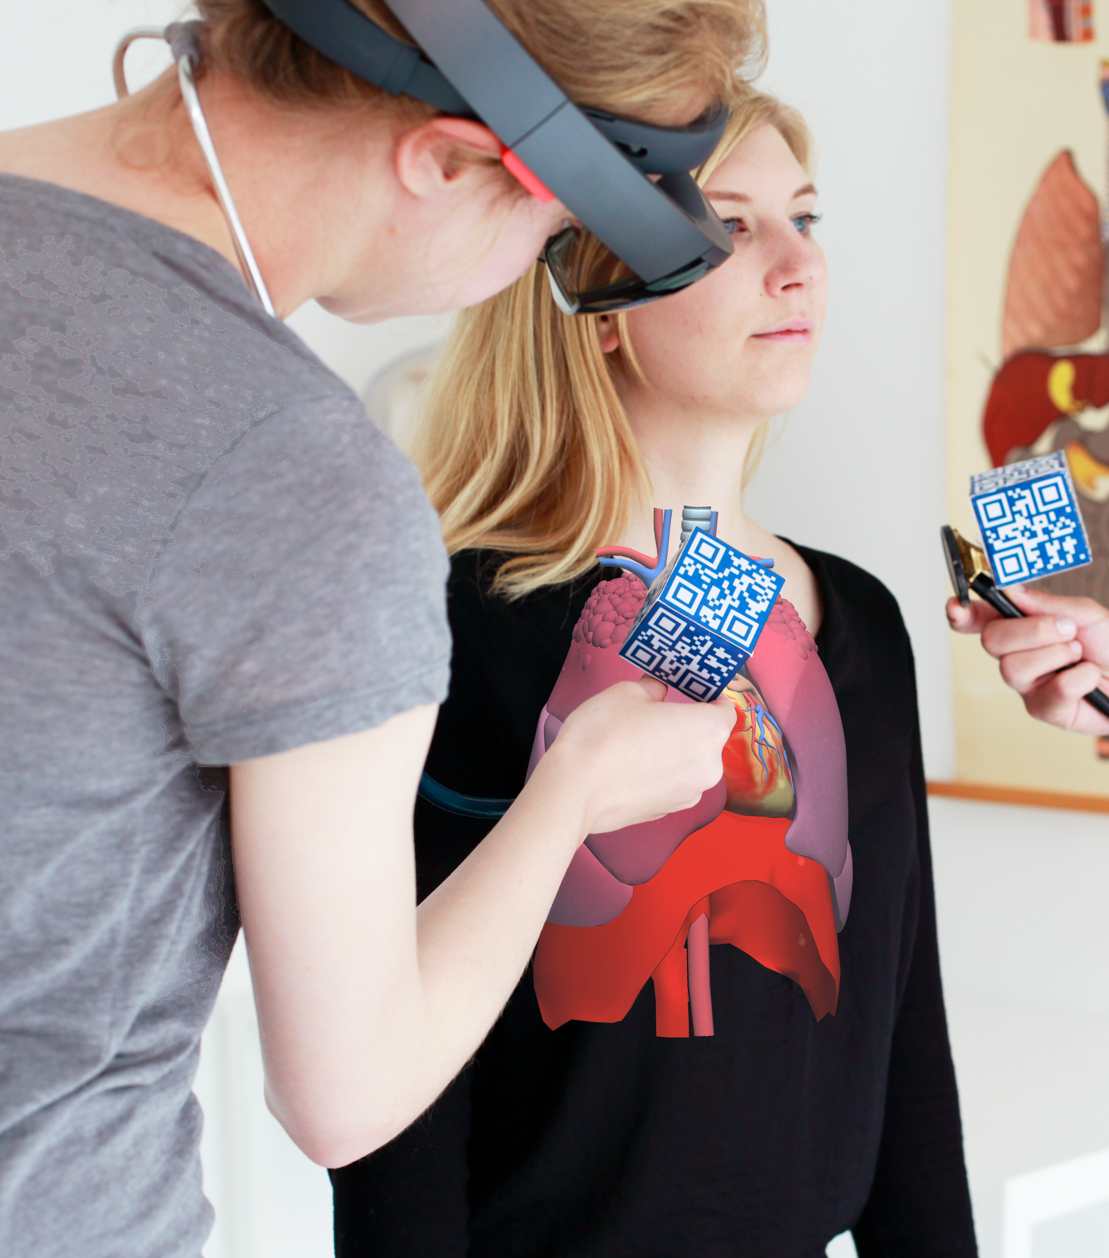
World-class research
Cutting-edge fundamental research
Interdisciplinary collaboration
Impact on society
International focus
Innovative teaching
Mono-, multi- and interdisciplinary
Focus on 21st-century skills
Relevant to society
Innovative use of technology
Notes:
RESEARCH
Our research is organised into 36 research institutes and spans a wide range of themes. Our research ranges from astronomy to nanotechnology, and from local to global challenges. We study urban issues in The Hague and children’s rights around the world.
Our Faculty of Humanities explores global languages, cultures and societies, our archaeologists uncover insights from the past, while our terrorism experts study today’s most pressing challenges.
Many of these issues are too complex for one discipline to solve. When researchers from different disciplines join forces, this results in new insights and solutions.
Our research has an impact on society. We use our knowledge to help address societal challenges, contribute to public debate and support policymaking.
TEACHING
We offer a wide range of mono-, multi- and interdisciplinary programmes. Our minors enable students to develop a multidisciplinary profile, and our new programmes are often strongly interdisciplinary.
With the world facing complex challenges that can rarely be solved by one discipline, our many interdisciplinary minors and programmes (e.g. International Studies) encourage our students to look beyond their own discipline.
We are integrating digital learning into our teaching. More than just online classes, this might involve interactive simulations, virtual environments and online collaboration tools.
Alongside research-based disciplinary knowledge, we place a firm emphasis on developing skills such as problem-solving, collaboration, communication and critical reflection. These are essential to a fast-changing job market and society, and their integration into the curriculum is innovative.
Many of our programmes and research projects have clear links to real-world challenges. Students are encouraged to think about the impact of their work on society and to seek solutions to today’s big issues. This contributes to a meaningful learning environment.

Slide 9

Interdisciplinary research and teaching
15 themes in 5 domains
Humans in the world | Resilient and learning society | Technology and society | Peace, justice, democracy and governance | Health and life sciences
Languages, cultures and worldviews Heritage Migration | Inequalities Generation of the future Social transitions | Sustainability and biodiversity Quantum and space AI for humans, society and science | Security, safety and cybersecurity Trust in polarised times Geopolitics in Europe and the world | Regenerative medicine Health and well-being Drug discovery and development
Notes:
Interdisciplinary collaboration − when researchers from a wide range of fields work together on a research or teaching project − is an important way to find answers to the complex, pressing issues of our time.
https://www.universiteitleiden.nl/en/research/our-research-organisation/interdisciplinary-programmes
Leiden University is a broad-based, international university. Our research and teaching is divided into five core domains.
https://universiteitleiden.nl/en/research

Slide 10
Research in figures (2025)
7,200
Publications
557
PhD defences
29
Spinoza Prizes
Until now
99
NWO Grants
16
ERC Grants
685
Professors
36% female
Notes:
Figures are from Leiden University’s annual report 2025 and the DataKompas
Curiosity-driven research – fundamental research in particular – is of great importance to Leiden University. Quality and excellence are guiding principles here. Our researchers are given the resources and space they need to excel. The number of highly cited researchers from Leiden per year is relatively high and above the global average.
Publications
Exact numer is 7,190
Spinoza Prizes
Leiden University is in the lead: since 1995, we have won 29 of the 113 Spinoza Prizes, the highest accolade in Dutch science, which is awarded by NWO.
(https://www.universiteitleiden.nl/en/academic-staff/leiden-spinoza-prize-laureates)
The figures for NWO grants and ERC grants reflect the grants awarded in 2025
Distribution of ERC Grants
Synergy 1
Proof of Concept 5
Advanced 3
Consolidator 2
Starting 5
Distribution of NWO-vernieuwingsimpuls grants
Veni 18
Vidi 14
Vici 4

Slide 11
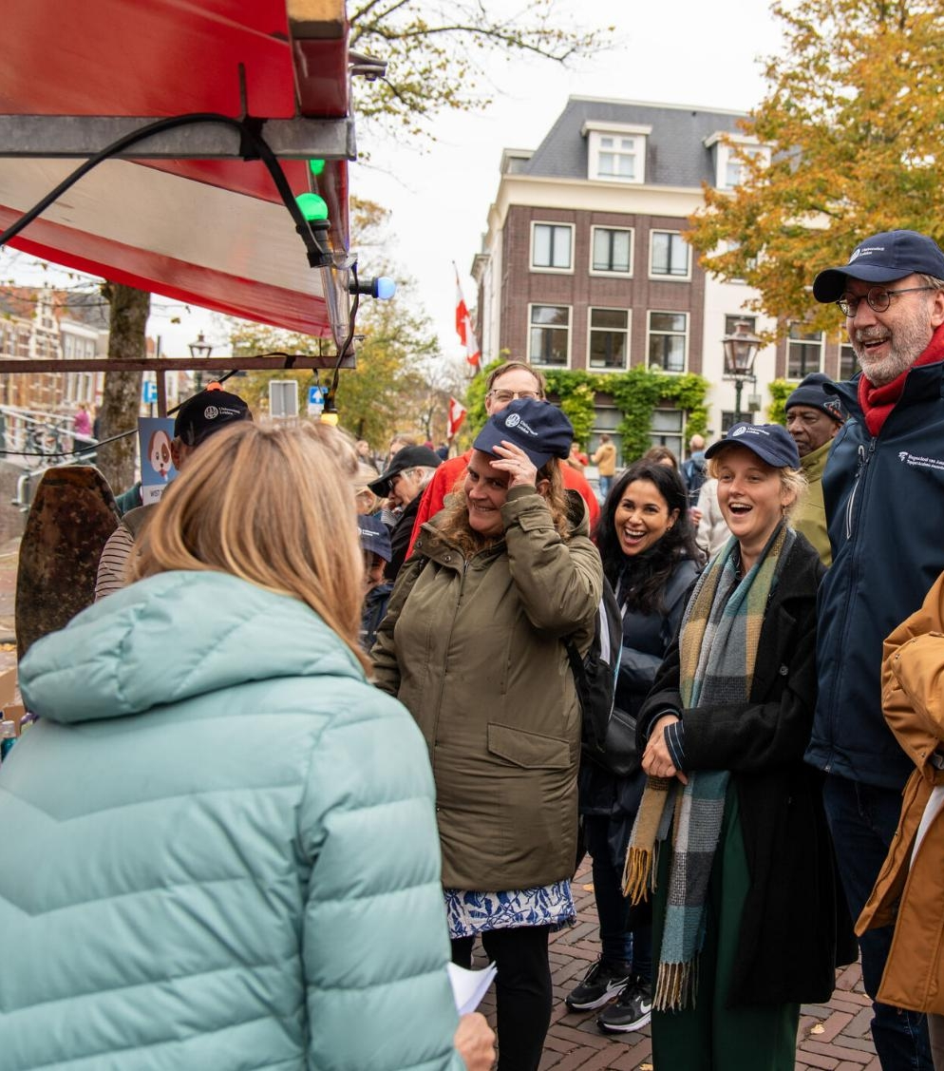
Innovation and knowledge transfer
Innovating with local, regional, national and international partners
Sharing knowledge to help solve the challenges of our time
Making science accessible to the general public
Notes:
Examples of partners
LOCAL
Leiden Bio Science Park
BioPartner Center Leiden
LeidenGlobal
Lorentz Center
Leiden City of Knowledge
Leiden Instrument Makers School
Leiden University of Applied Sciences
MBO Rijnland
REGIONAL
Leiden-Delft-Erasmus Universities
Collaboration with institutions in The Hague
Key Region Leiden
Medical Delta
NATIONAL
Universities of the Netherlands
INTERNATIONAL
League of European Research Universities
Una Europa
We work with many different partners at the local, regional and international level. We collaborate closely with the Leiden University Medical Center (LUMC) in our research and teaching (through our professors and medicine programme), and are one of the partners in Medical Delta, the Zuid-Holland alliance of universities, industry and government working in the life sciences and medical technology.
Luris connects researchers from the university and the LUMC with the market, and the municipalities of Leiden and The Hague help us develop our activities in the two cities.
In Leiden our researchers work with specialised businesses at the LBSP on discoveries and products in the life sciences.
In LDE, we work with Erasmus University and Delft University of Technology on joint research and teaching.
We are a member of LERU along with 23 other European research universities.
We offer joint programmes and research options together with the Royal Conservatoire and the Royal Academy of Art in The Hague.
And there are plenty more examples of collaboration: with the LUF, for example, our alumni fund.
Our research and teaching have an impact on society in various ways: we advance knowledge, we provide highly skilled graduates and our alumni make a difference to society. We work with the profession (many of our professors are active in their field outside the university), we carry out research for ministries and civil society organisations, we work with industry, for example at the LBSP.
Our accessible science reaches a wide audience: at Lowlands, during pop-up lectures or science cafés in The Hague, the Night of Discoveries, 3 October University, the Science Market on 3 October, Leiden Museum Night and with popular science books and appearances in the media.
We have an academic and professional impact, on the commercial and the government sectors. Our knowledge reaches a wide audience and our alumni are committed to society and education.
(https://www.universiteitleiden.nl/over-ons/impact)
https://www.universiteitleiden.nl/jaarverslag

Slide 12
Teaching in figures (2025)
33,500
Students
10,000
Graduates per year
51
Bachelor’s
83
Master’s
22%
International students
100+
Programmes for professionals
Notes:
Figures are from Leiden University’s annual report 2025
Exact number of students: 33,494

Slide 13
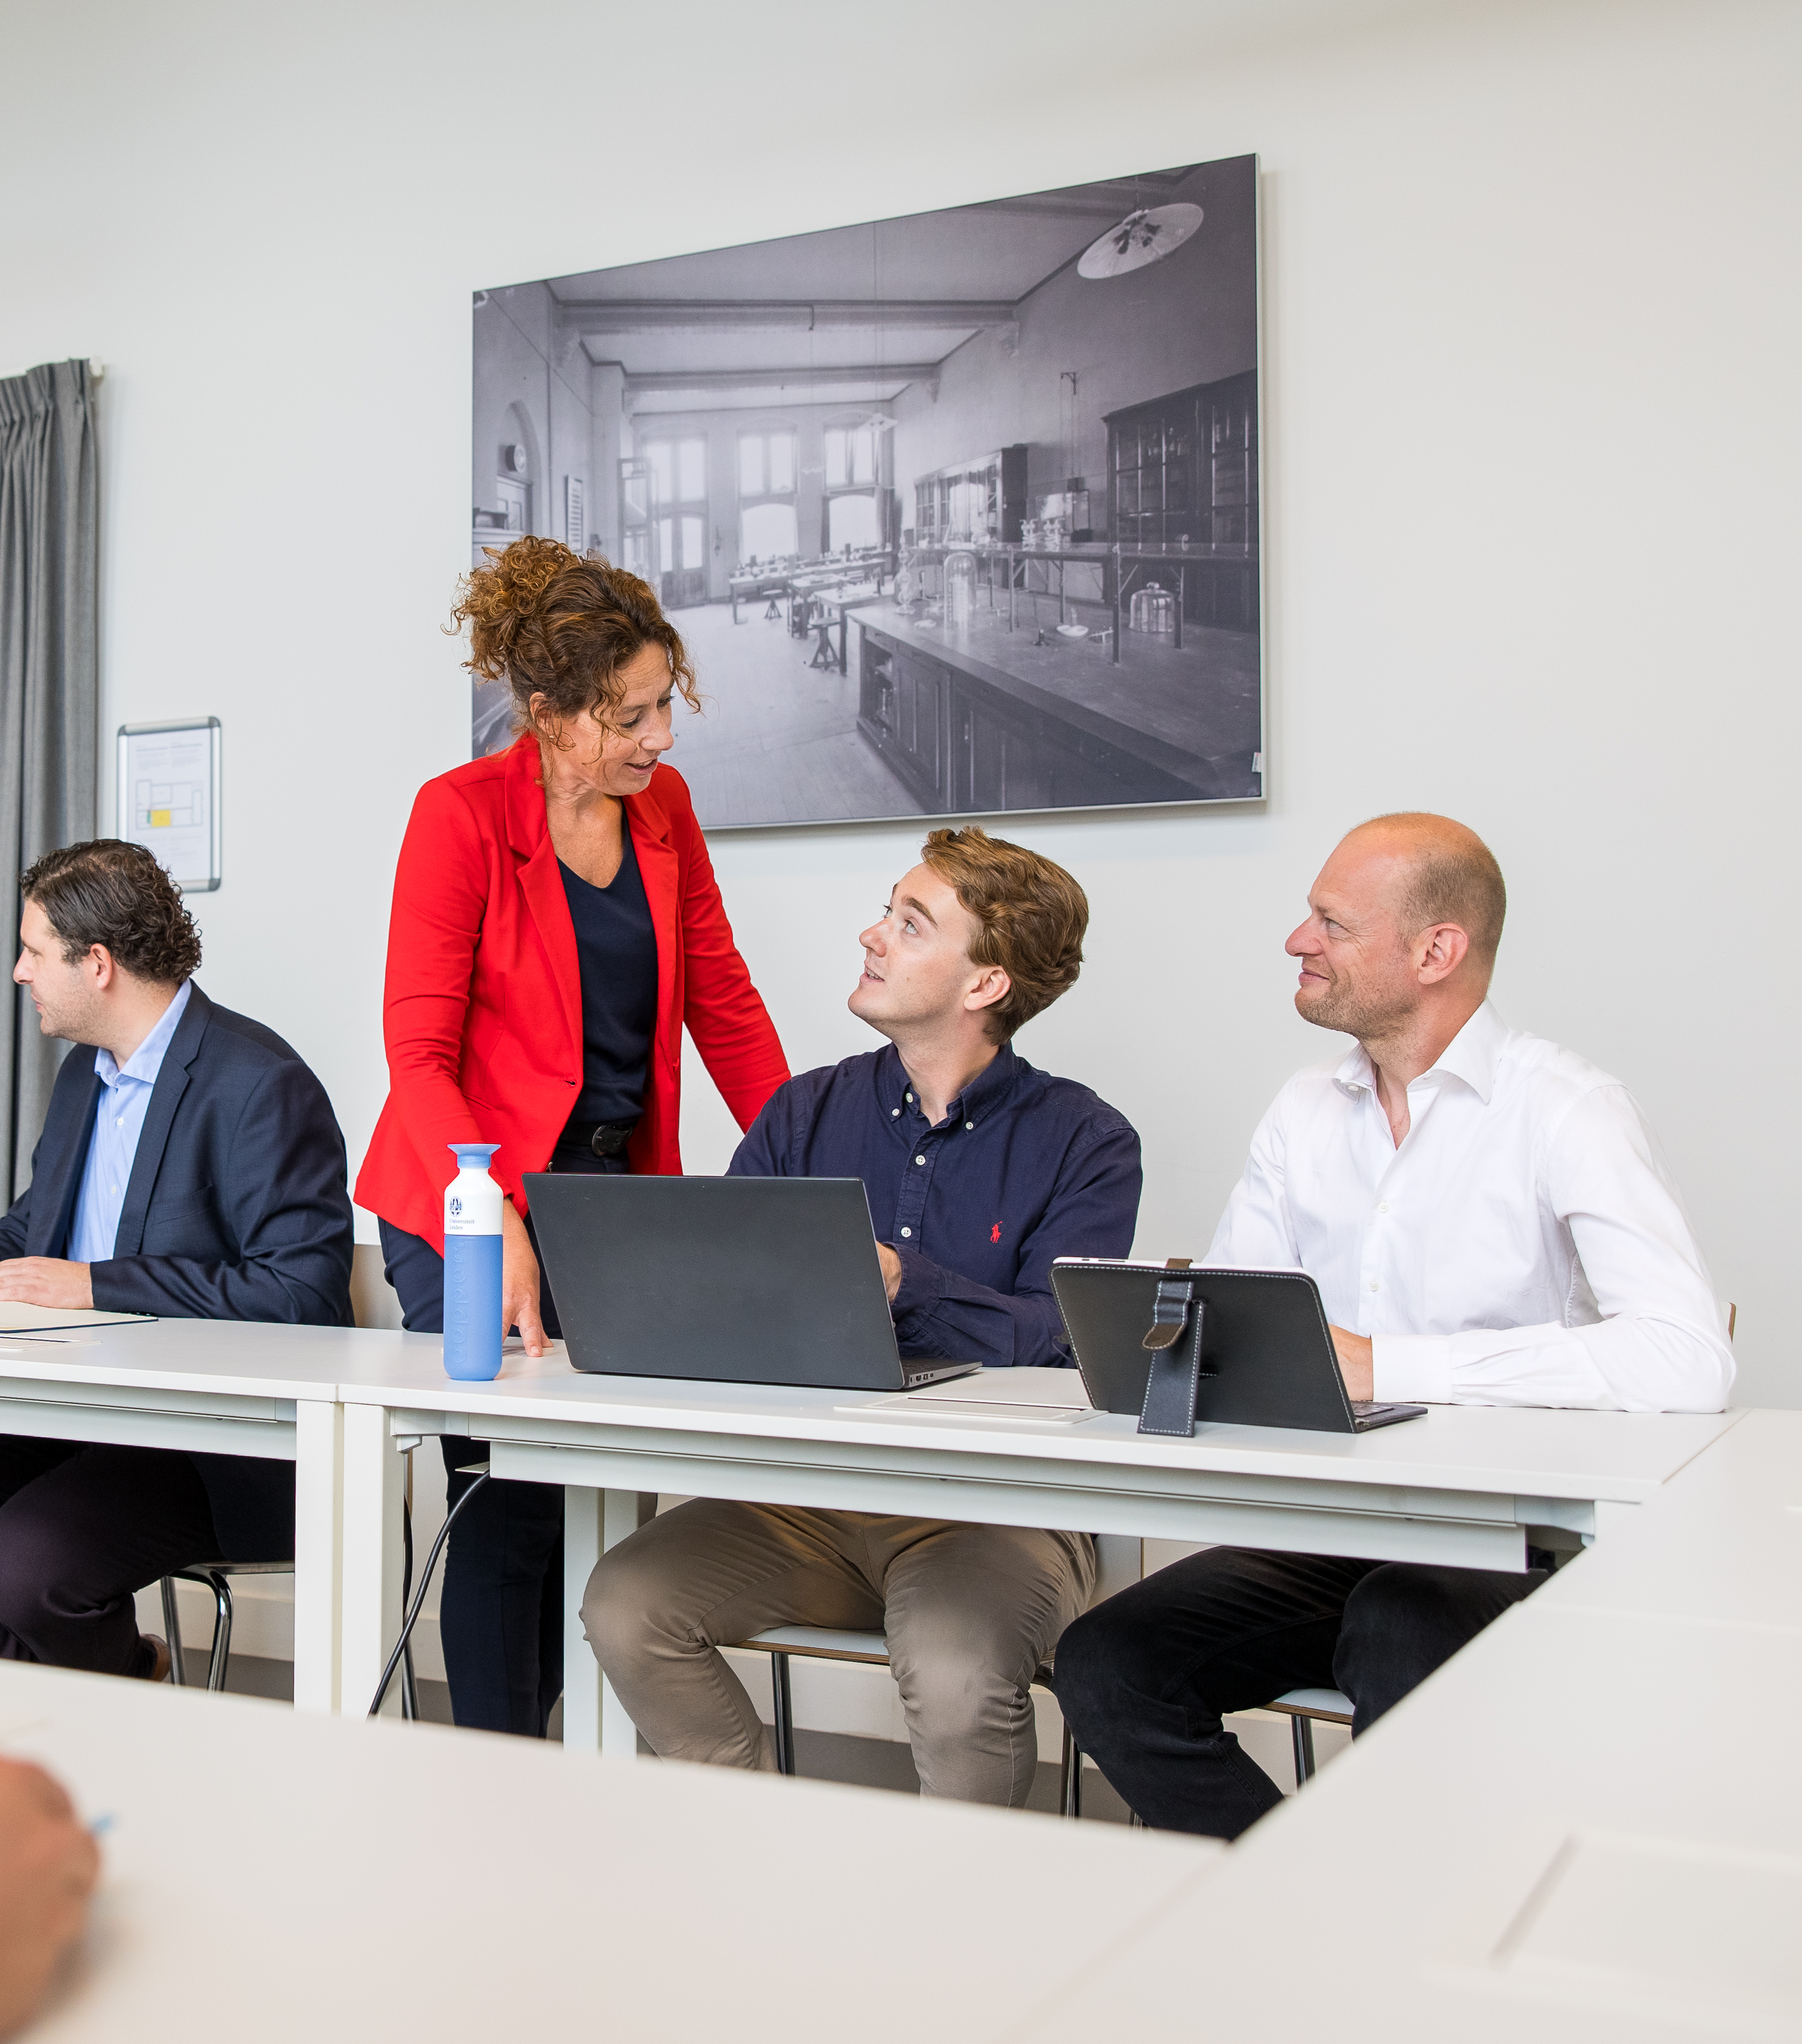
Lifelong learning
Professional education
Flexible learning
Courses for refugees
Study abroad
Summer schools
Notes:
We offer opportunities for adult learners, ranging from short courses for those looking to explore new ideas to longer programmes for those seeking to further their careers. From a one-off evening lecture and a course of a few months to a part-time programme spanning several years, there are many different ways to study at Leiden University.
https://www.universiteitleiden.nl/en/education/other-modes-of-study
https://www.universiteitleiden.nl/en/education/education-for-professionals
https://www.universiteitleiden.nl/en/education/other-modes-of-study/education-for-refugees

Slide 14

International collaboration
Focus on
Northeast and Southeast Asia
Latin America
Africa
Europe
Partnerships with
Academic partners
Non-academic partners
Notes:
Leiden University has always had partners across the world, with a particular focus on Europe, Asia, Africa and Latin America.
A global network of more than 600 universities and partners encourages our students to do part of their degree programme abroad.
Academic alliances foster research collaboration, student exchanges and talent development.
Non-academic partners include ministries and research councils
Alliances:
League of European Research Universities
Una Europa
Het Europaeum
European University Association
Euroscholars
Coimbra Group
Erasmus Mundus
International Association of Universities
(https://www.universiteitleiden.nl/over-ons/samenwerking/samenwerkingsverbanden/internationaal)

Slide 15
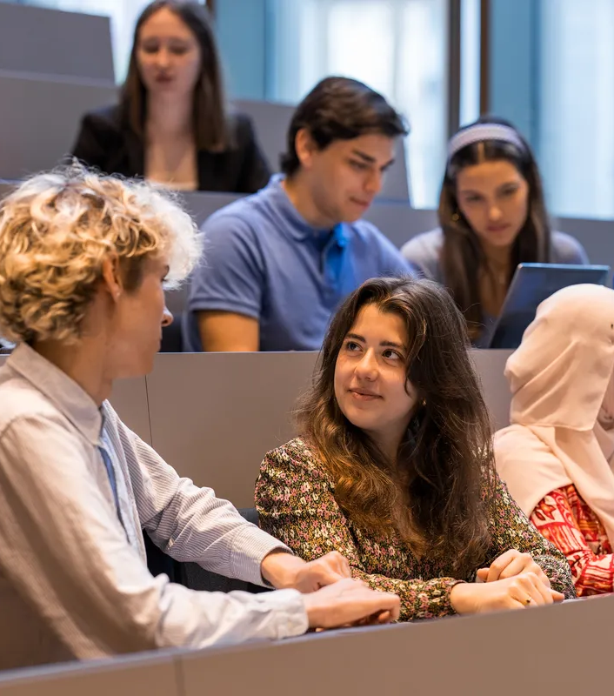
Why do students choose Leiden?
Wide range of programmes
Small scale
International
Research-based teaching
Friendly student cities
Good reputations
Notes:
Why do students choose us? Research has shown that this is what attracts them to our university. Thousands of students visit our open days with their parents each year.
https://www.universiteitleiden.nl/en/education/bachelors/information-activities/open-days
https://www.universiteitleiden.nl/en/education/masters/information-activities/masters-open-day

Slide 16
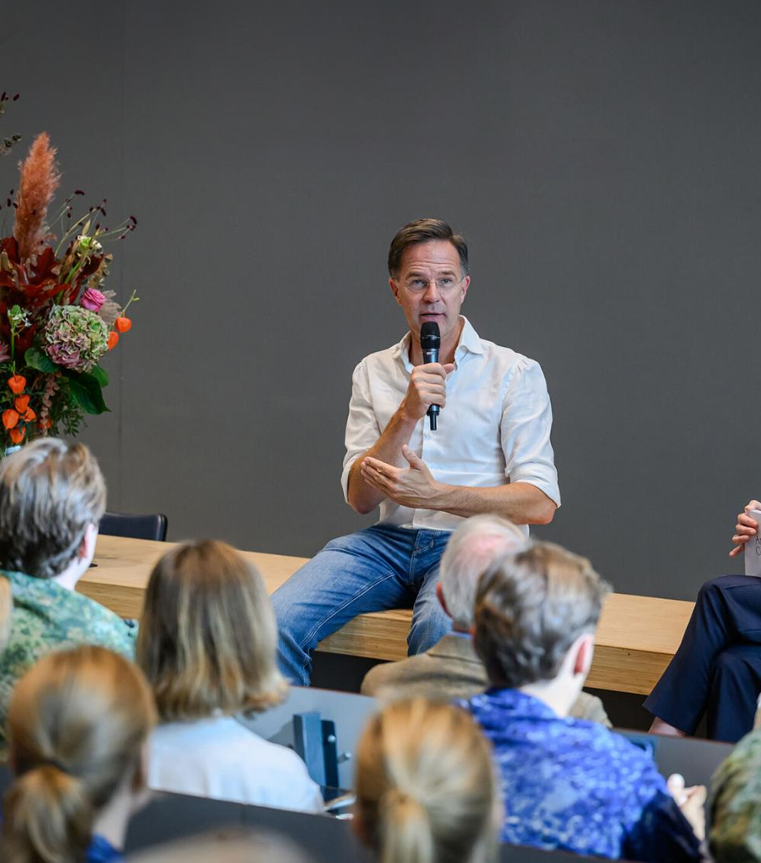
Our alumni
Over 155,000 in more than 150 countries
Famous alumni
Rembrandt van Rijn
King Willem-Alexander
Princess Beatrix
Mark Rutte
Eva Jinek
Notes:
Famous alumni: from Rembrandt, whose matriculation from 1620 can be found in our University Library, to members of the Royal Family and various ministers, state secretaries and MPs. Famous women who have studied at Leiden include presenter Eva Jinek and writer Franca Treur.

Slide 17
universiteitleiden.nl/en

